Slide 1
MARKETMIND : GENERATIVE AI POWERED SALES & MARKETING INTELLIGENCE PLATFORM
Team : TechTitans
S. Akhila
J. Asritha
A. Raveena
CH. Devendra
R. Arshitha

Slide 2
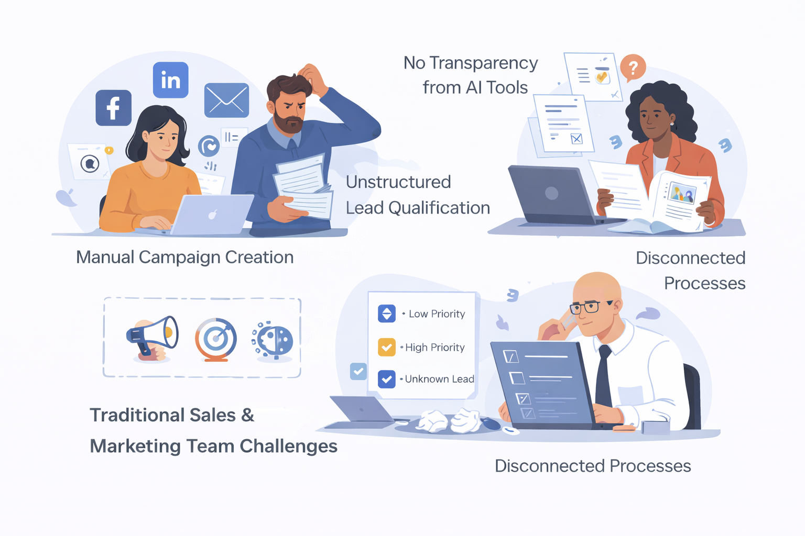
MarketAI Suite – AI Powered Sales & Marketing Platformwith Groq ( GenAI for Business Intelligence Track)
Sales and marketing teams lack an AI system that supports real business decision-making.
Campaign creation and pitch development are manual and repetitive.
Lead qualification is inconsistent and not data-driven.
Existing AI tools generate content but lack explainability.

Slide 3
Our Solution - MarketMind – AI That Thinks & Explains
AI-powered campaign engine generating platform-ready posts, ads, emails, and video prompts
Persona-based sales pitch generator with 5 tone variations and structured outreach templates
Intelligent lead scoring with conversion probability and priority ranking
Explainable AI layer providing clear decision reasoning and confidence score

Slide 4
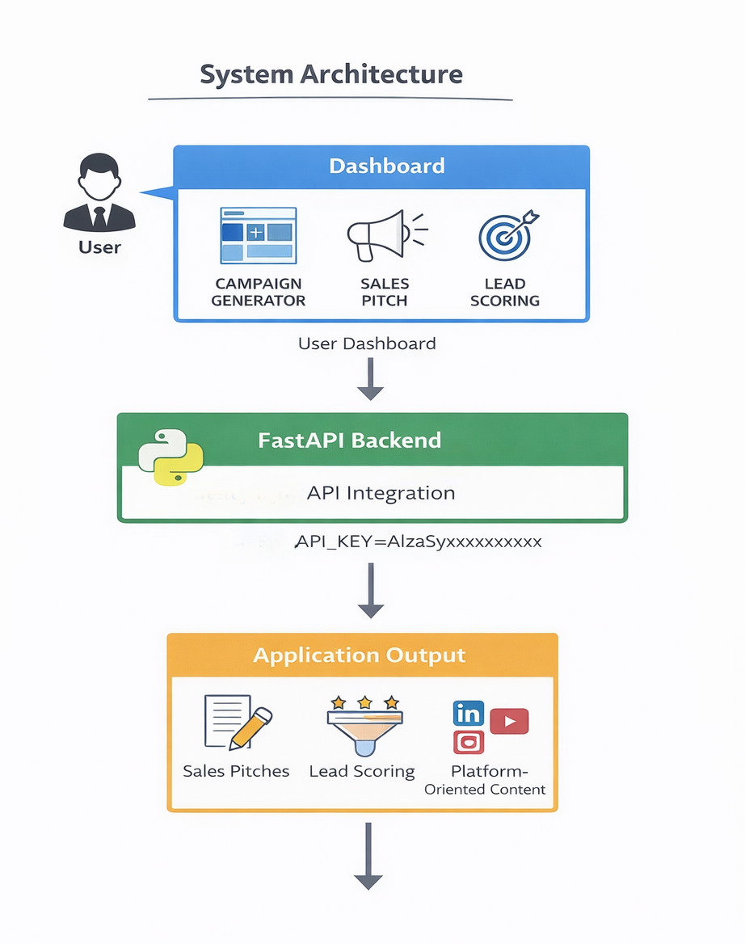
System Architecture

Slide 5
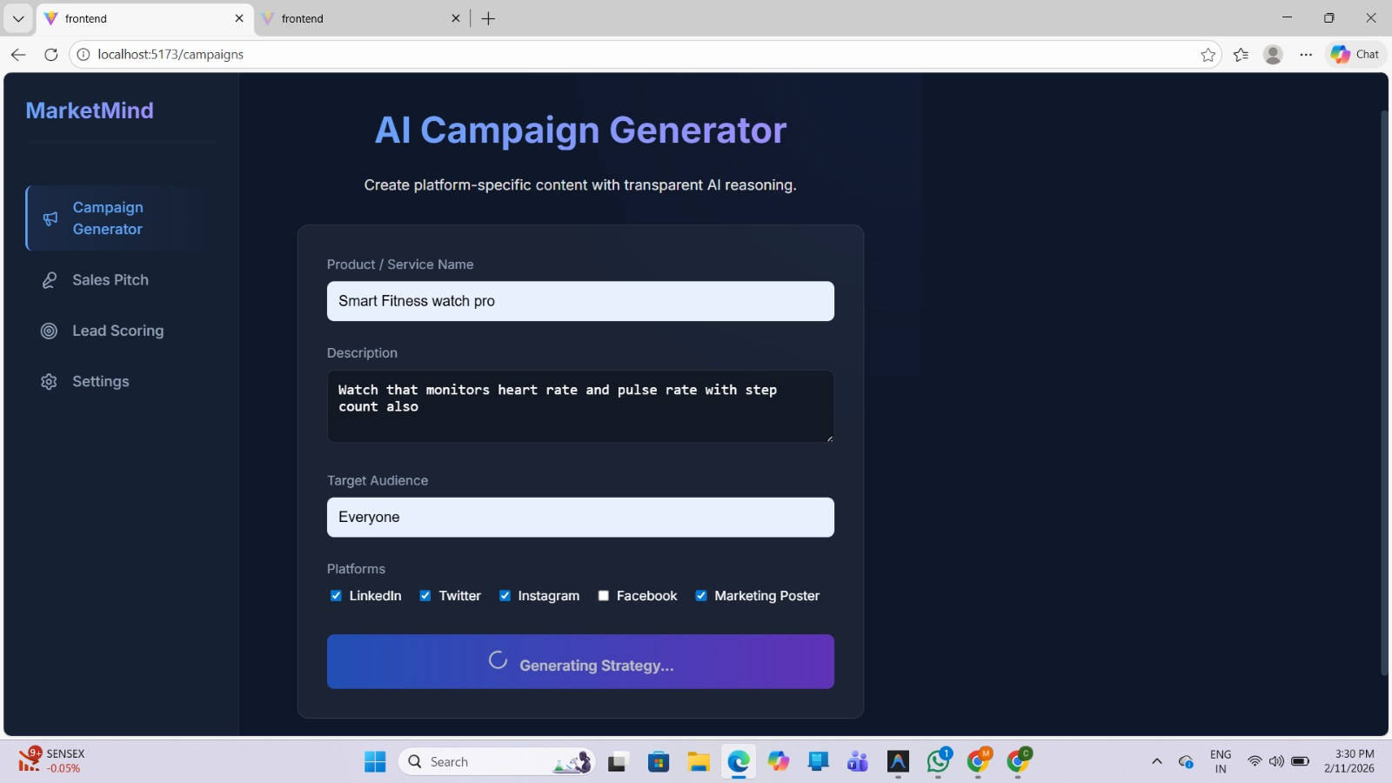
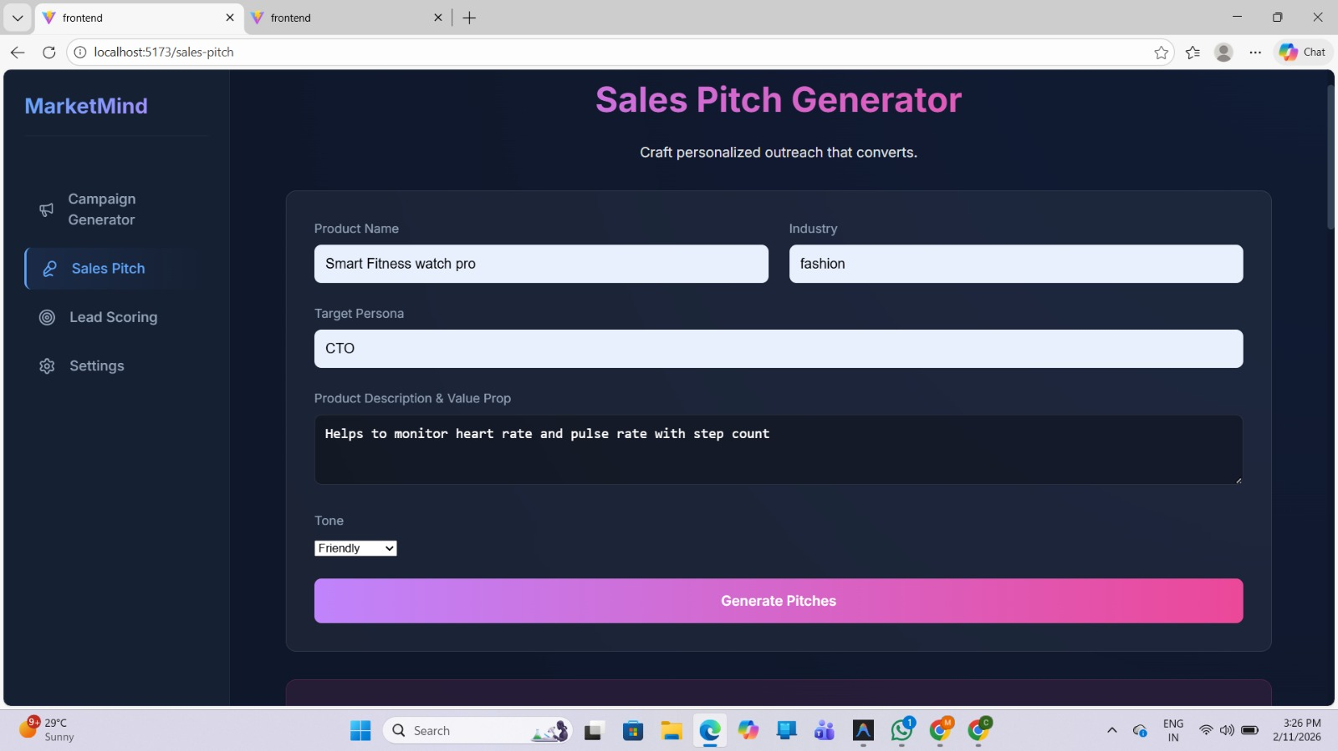
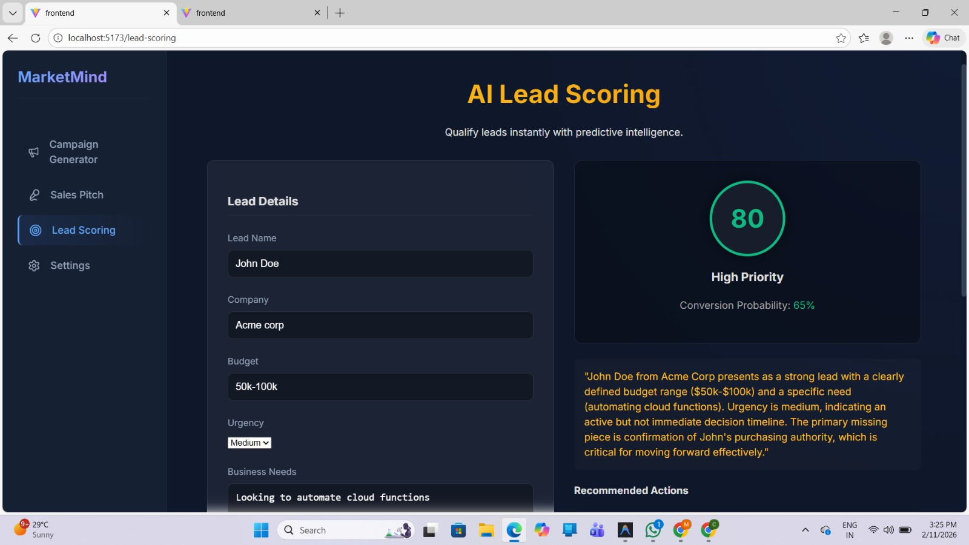
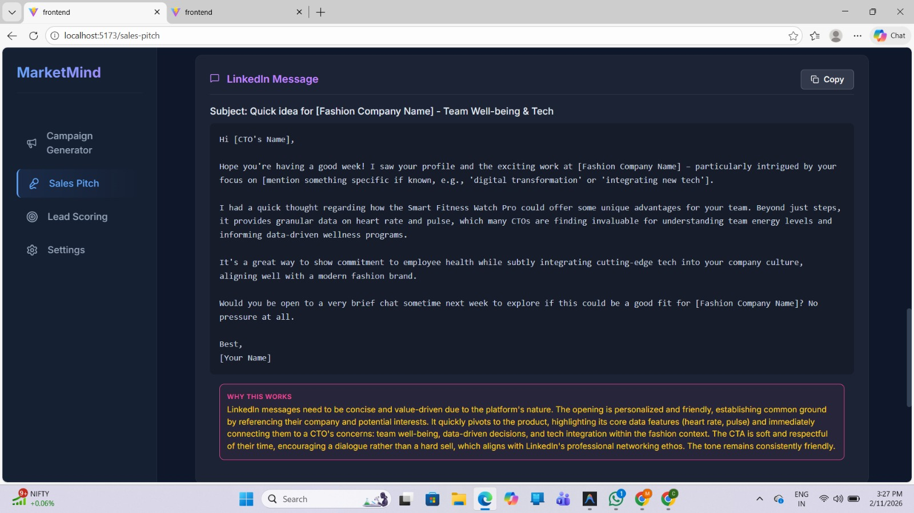
Results

Slide 6
Thank You

